Slide 1
Cloud & Edge services you can trust
Federated Marketplace of Cloud, Edge & AI services that you can trust
August 2024
Jesus Ruiz

Slide 2




The DOME project
Digital Europe Programme
DIGITAL-2021-CLOUD-AI-01
Started production July 4th, 2024
Only catalog, not procurement.
Procurement will be added some months later.
Will evolve according to feedback from users until the end of the project.
Budget: 40 M€
Funding 50%
Consortium: 38 Partners
+5 Affiliated Entities
Duration: 36 Months
Jan 2023 – Dec 2025
2023
2024
2025

Slide 3


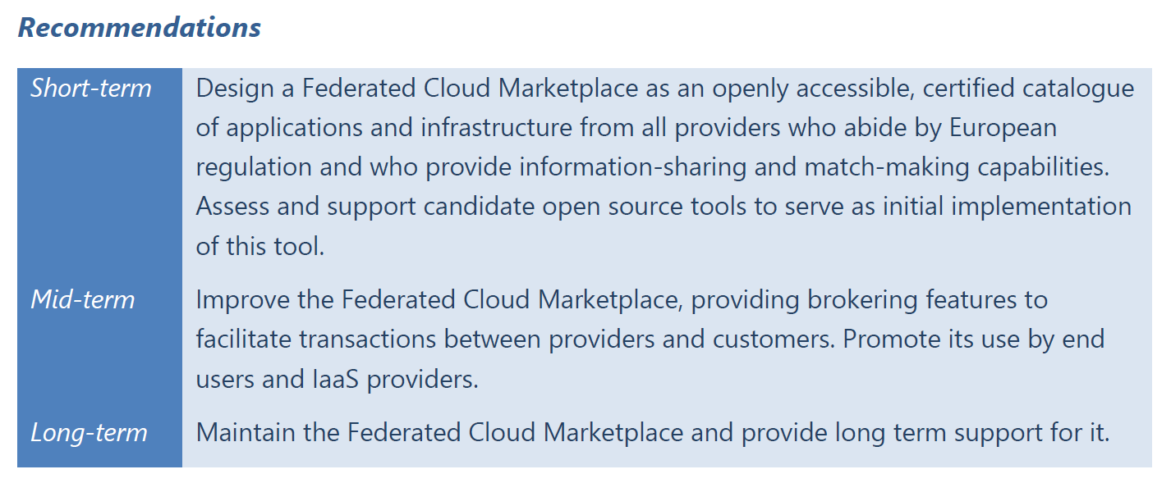

Slide 4

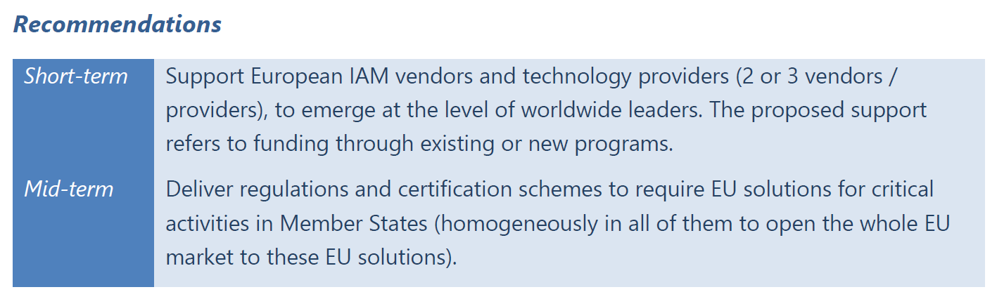

Slide 5

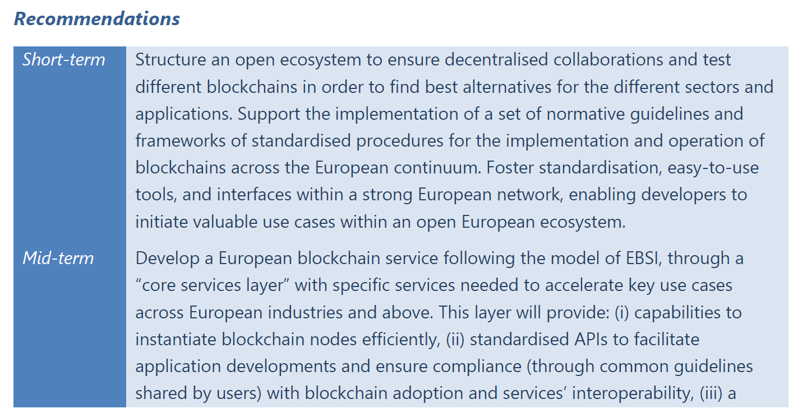

Slide 6








Introducing our marketplace
DOME
What is DOME marketplace?
Simplify acquisition of Cloud Services
Enforce and promote trust and compliance.
Access different services across the EU
Cloud & Edge services you can trust
dome-marketplace.eu

Slide 7


DOME
One-stop Shop for your trusted Cloud, Edge & AI Journey
Verified Cloud, Edge & AI Services
Cloud & Edge services you can trust
dome-marketplace.eu

Slide 8











Benefits & Roadmap
DOME
Matching Supply & Demand
Marketplace Advantages
Sellers
Buyers
Become a trusted player
Single catalog of verified services
Publish verified offering.
Seamless discovery and experience
Compiled services to match demand
Fast & efficient purchase pathway
Increase visibility and outreach
Safe and trustful data services
Capability to go to the market
Cloud & Edge services you can trust
dome-marketplace.eu

Slide 9

Benefits & Roadmap
DOME
Roadmap
The DOME business aims to create a collaborative environment where we can grow together with the platform adopters.
July 4th 2024
1.0 Catalogue
December 2024
1.1 Purchase
December 2025
1.2 New features
Publish your services
Enjoy Full Experience
New & Advanced Features
Service Discovery
Trusted services with Verified Credentials
Offline contact provider / customer
Services publication is free
Free for both Sellers and Buyers
Payments gateway (Services)
Providers set up direct selling models and pay a minimum compliance check cost + a small % of DOME revenues - early bird discounts
Group services in a single purchase
New vertical functionalities delivered to support vertical market needs
Total handover to the DOME operator
Cloud & Edge services you can trust
dome-marketplace.eu

Slide 10

Scope of functionalities in version 1.0 (Catalogue)
Catalogue management
Contracting, payment and billing
Catalogue Edit & Import
Service
listing
Catalogue Replication
Search & Browse
Contracting
Billing and Invoicing
Revenue Sharing
Federated Payments
Delivery management
Negotiation
Marketing&Communication
Operations
Service Activation
Service Configuration
Consumption and Usage Tracking
Tailored Offerings
Tendering
Marketing & Networking
Training
HR & Admin
Mgmt.
Finance
Security and Trust
Quality of Service
Infrastructure
Onboarding
Certification Compliance
Identity and Access Management
Customer Support
Basic Reporting and Analytics
Platform
Hosting
Planned (no date)
System Services
Support Services
Infrastructure services

Slide 11
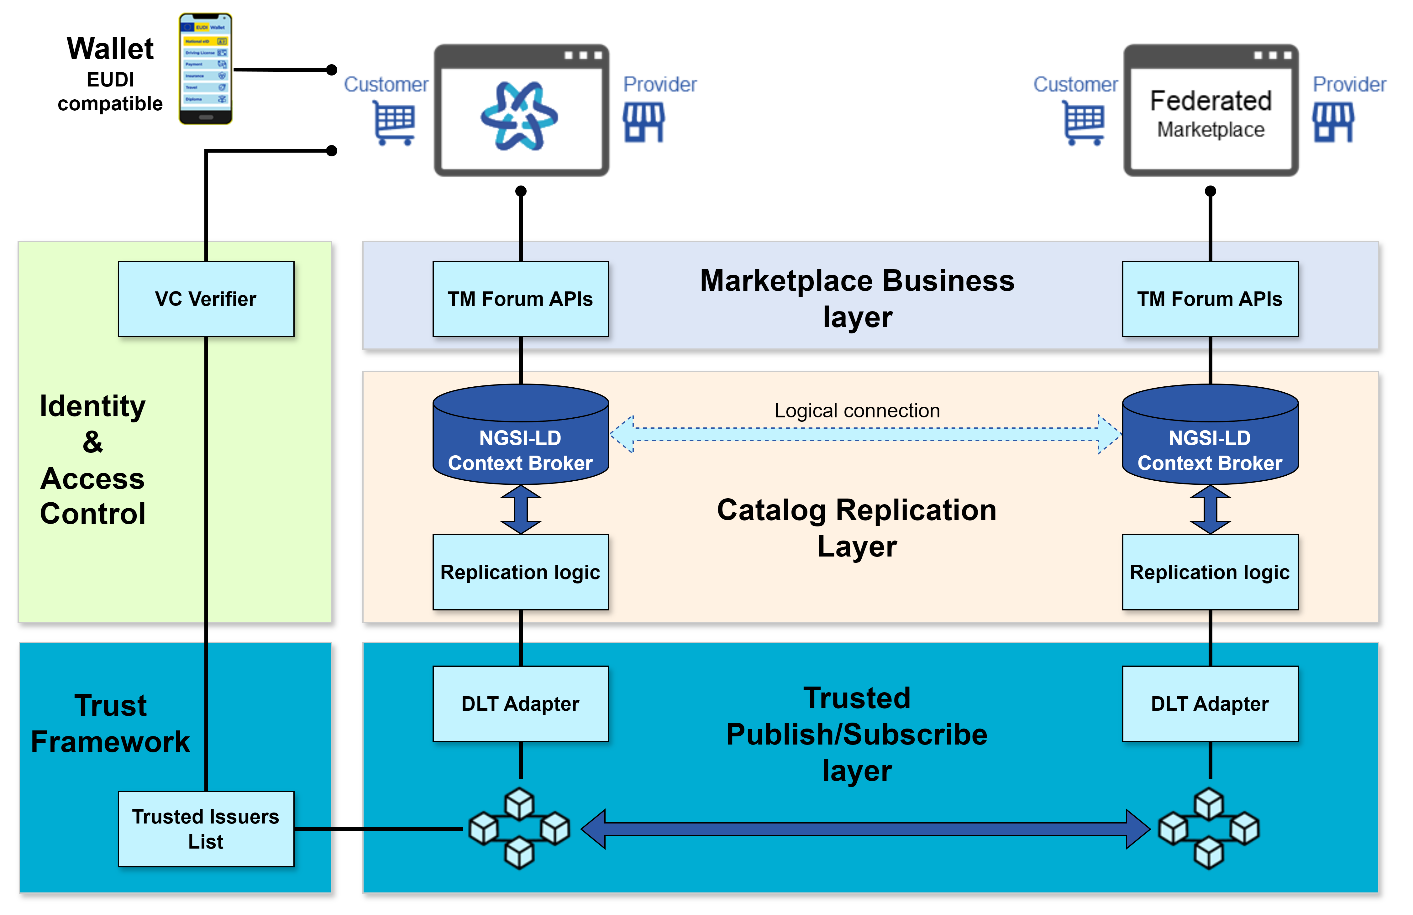

Slide 12
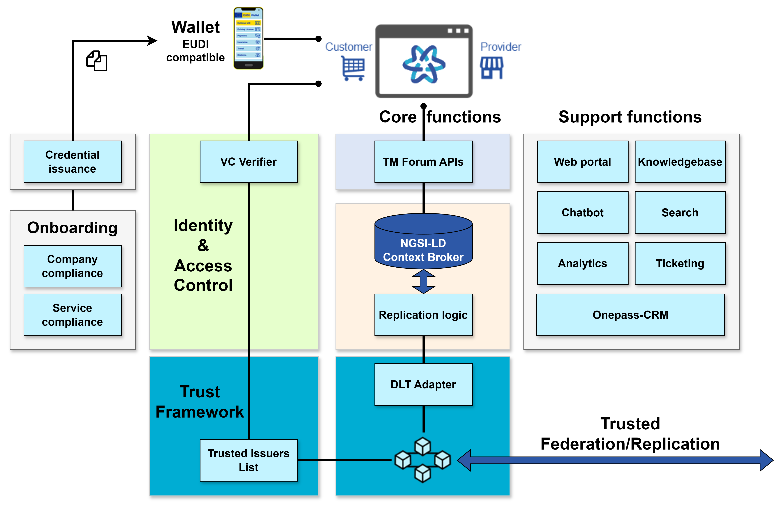

Slide 13
Lower barrier of entry: Access Nodes as a service for federation participants
Operated by DOME Operator as a service
Operated by any entity as a service (maybe published in the catalogue)
May include the whole marketplace SW, including the BAE

Slide 14
Identity & Access control
Cloud & Edge services you can trust
dome-marketplace.eu

Slide 15
eIDAS2 Regulation (11 April 2024) on the European Digital Identity Framework
Section 1, Article 5f-2:
Where private relying parties that provide services are required by Union or national law to use strong user authentication for online identification or where strong user authentication for online identification is required by contractual obligation, including in the areas of transport, energy, banking, financial services, social security, health, drinking water, postal services, digital infrastructure, education or telecommunications, those private relying parties shall, no later than 36 months from the date of entry into force of the implementing acts referred to in Article 5a(23) and Article 5c(6), accept European Digital Identity Wallets that are provided in accordance with this Regulation.
Source: Regulation (EU) 2024/1183 of the European Parliament and of the Council of 11 April 2024 amending Regulation (EU) No 910/2014 as regards establishing the European Digital Identity Framework

Slide 16
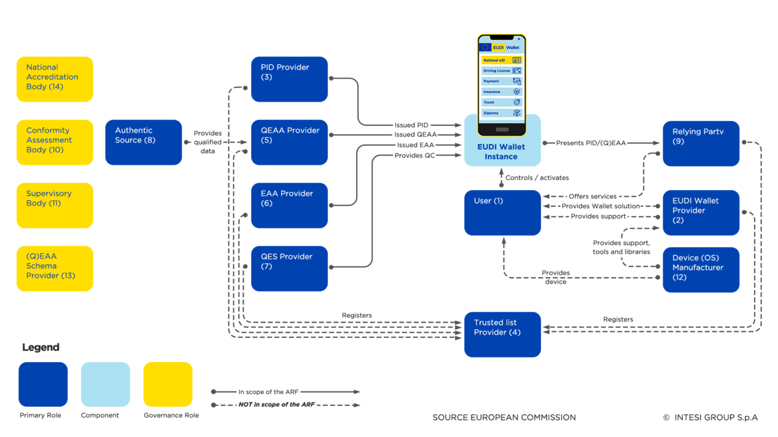


Authentication aligned with EUDI Wallet
Holder
Issuer
Verifier
DOME
DOME

Slide 17







Verifiable Credentials as electronic Powers of Representation
Electronic identification
Electronically identify users from across Europe and with other regions with mutual recognition.
Signatures & Trust Services
Electronic signatures to indicate agreement with a document with no repudiation.
Legal
Representative
Employees can prove that they can act on behalf of the company for specific and restricted purposes
Legal Entity
(company)
Electronic Mandate
Onboarding service
Employee

Slide 18
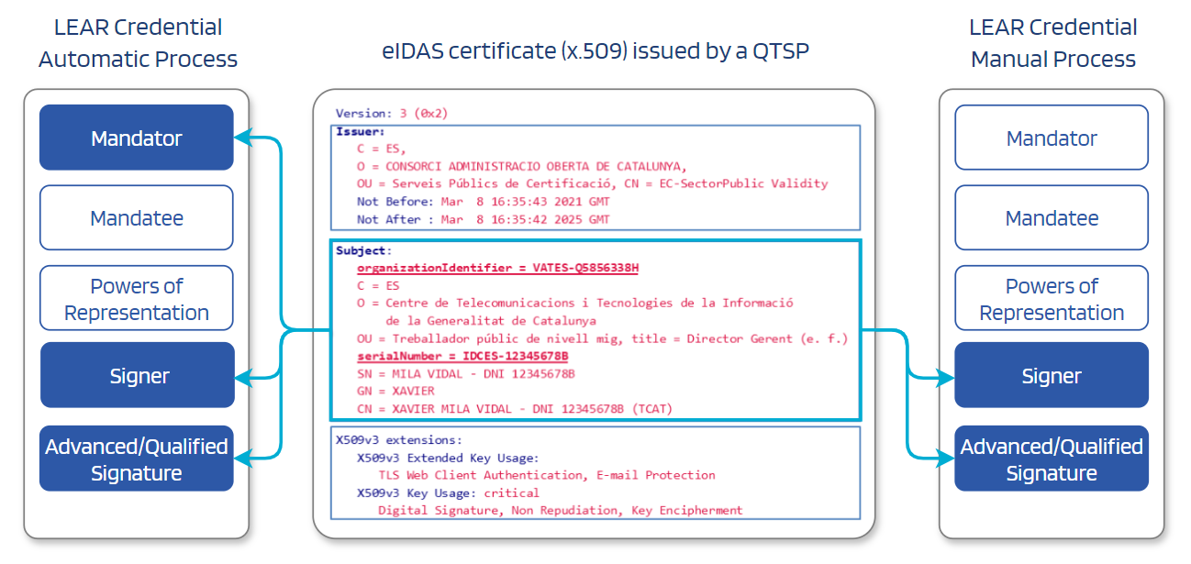
LEAR Credential signature with Mandator eIDAS

Slide 19
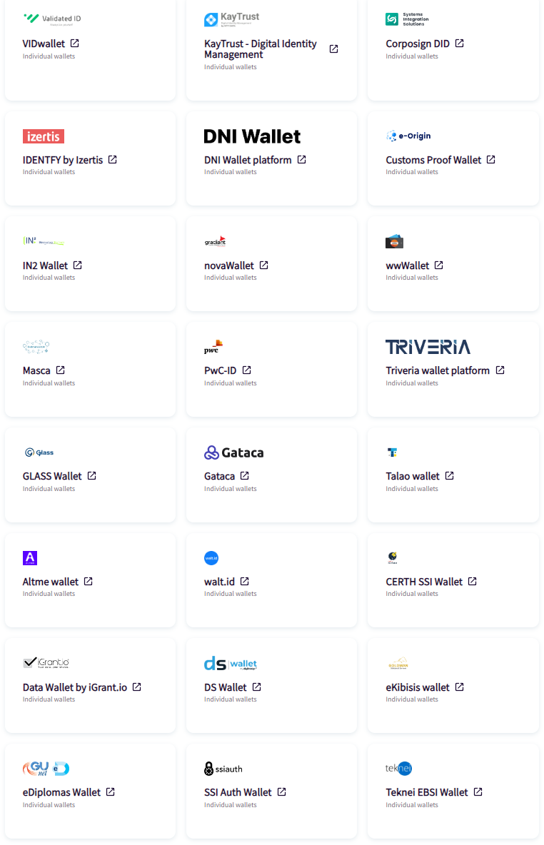
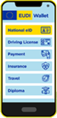
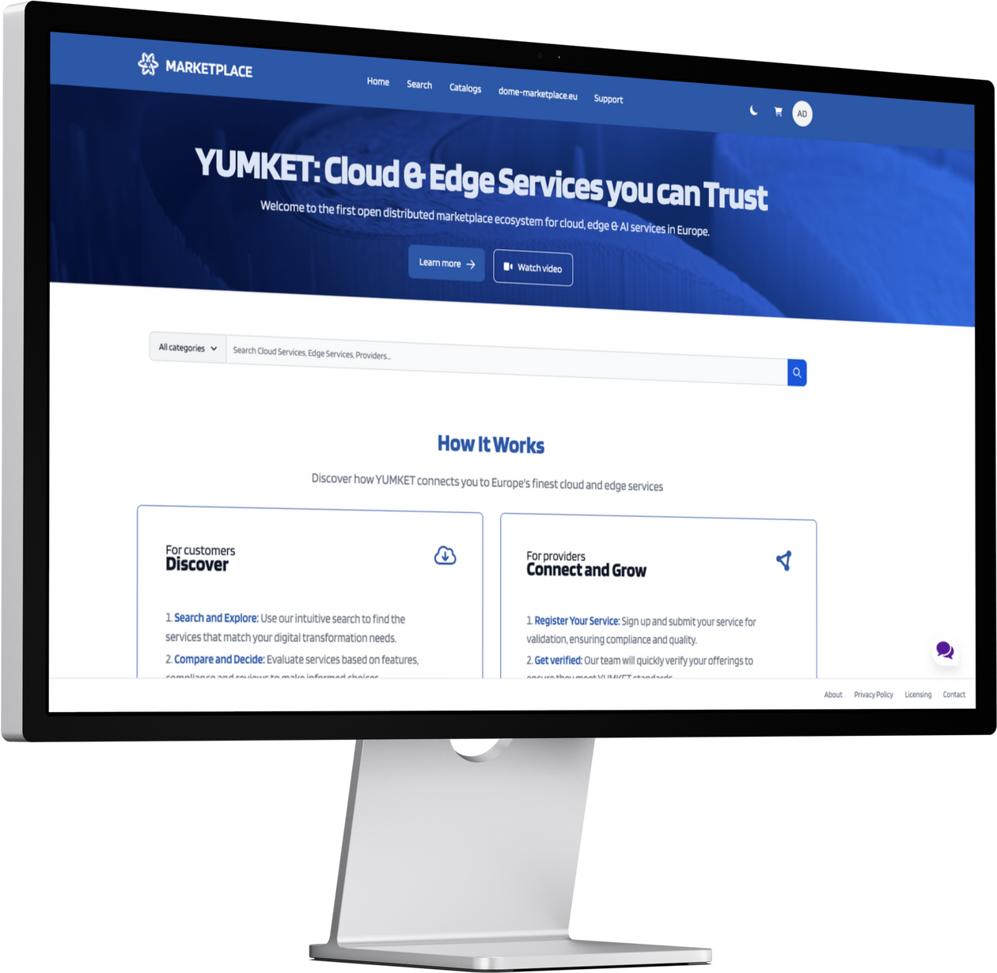
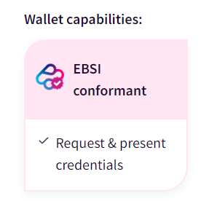
Open wallet ecosystem

Slide 20

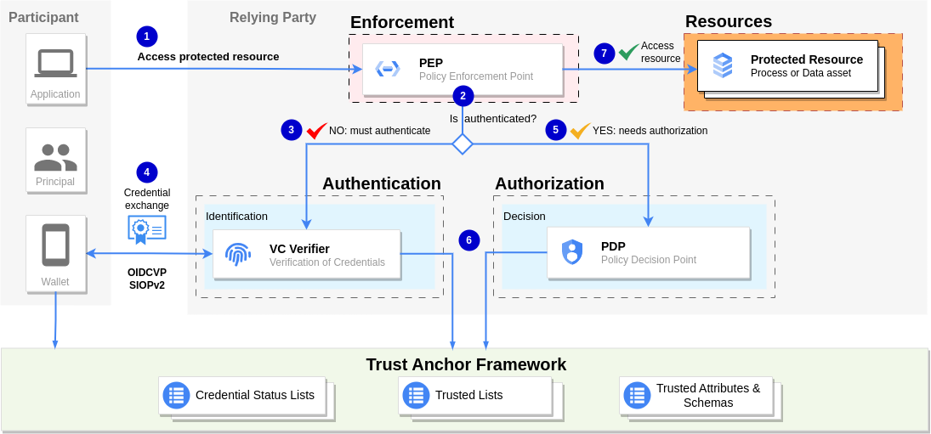
Authentication & Access Control based on Powers of Representation

Slide 21
Onboarding
Cloud & Edge services you can trust
dome-marketplace.eu

Slide 22
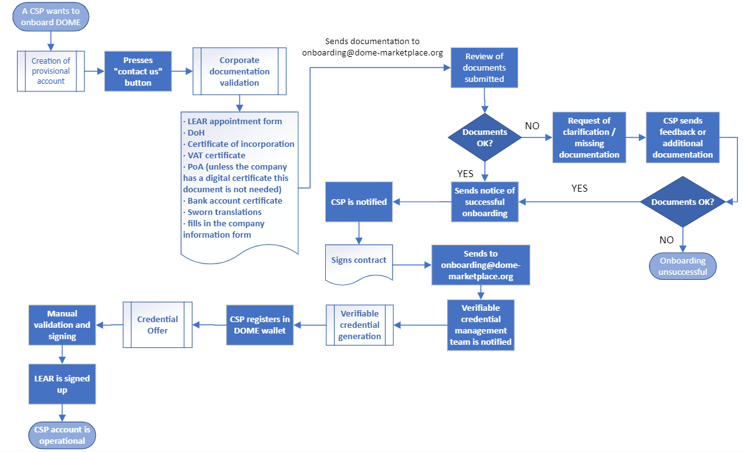
Onboarding process: launch of process and document gathering

Slide 23
Onboarding process: legal verification and contract signed

Slide 24
Onboarding process: issuance of verifiable credential

Slide 25
Onboarding process: general overview of the process

Slide 26
Decentralised Replication
Cloud & Edge services you can trust
dome-marketplace.eu

Slide 27




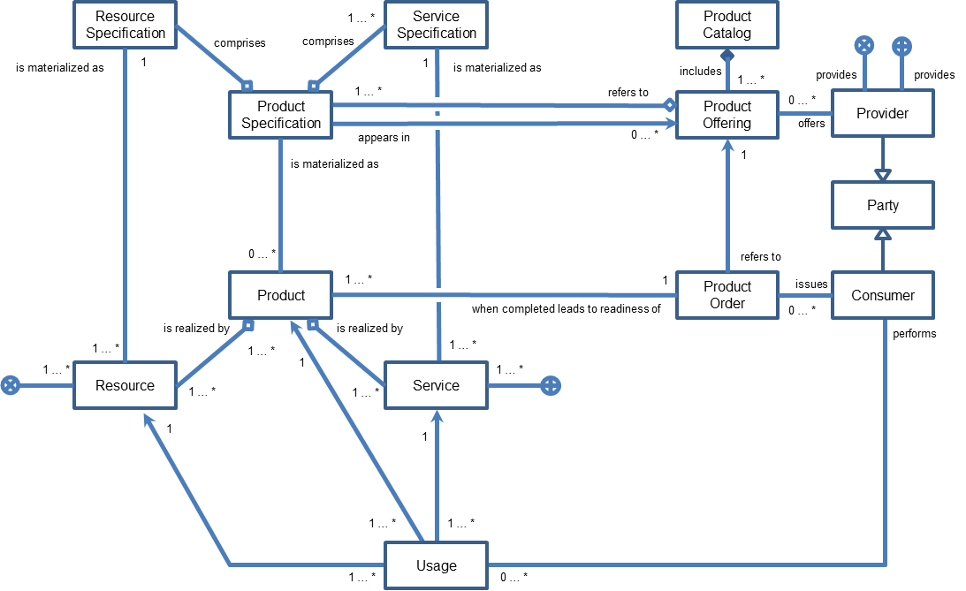

Replication requires common data model and APIs
DOME instance
Replication of Product Offerings
Customer
Provider
Customer
Federated
Marketplace
Provider
Customer
Federated
Marketplace
Provider
TM Forum Data Model
TM Forum APIs
TM Forum APIs
TM Forum APIs

Slide 28
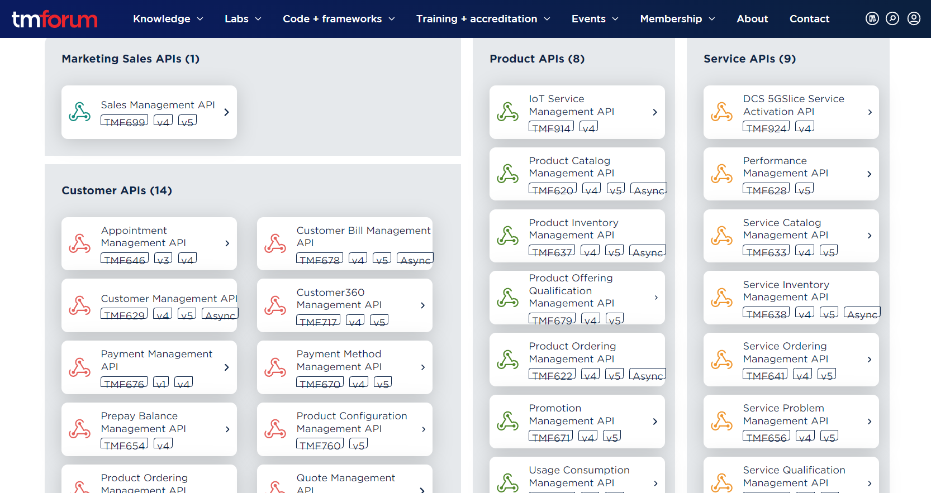
TM Forum datamodel and APIs for Marketplaces

Slide 29
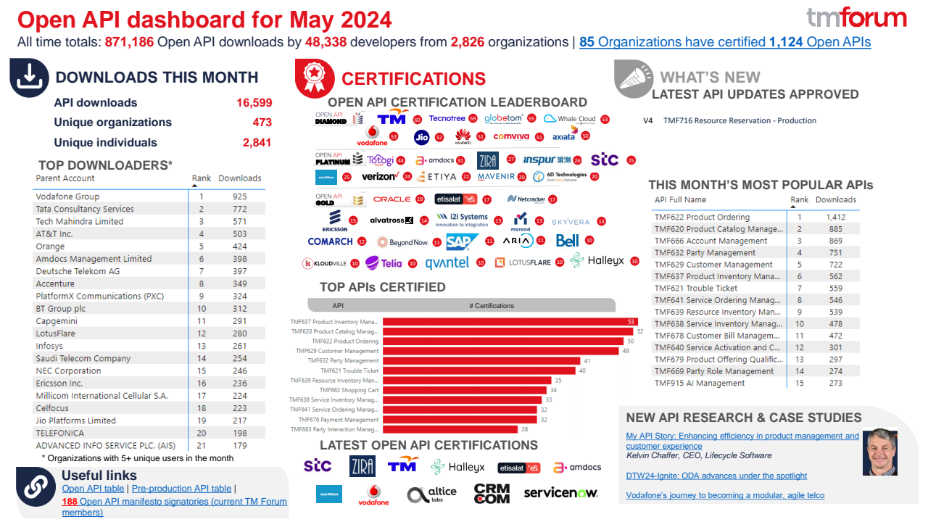

Slide 30

TM Forum APIs for Marketplaces - Model (Simplification)
Resource Specification
1 … *
Service Specification
Product Catalog
comprises
comprises
is materialized as
1
1
is materialized as
includes
provides
provides
1 … *
refers to
1 … *
Product Specification
Product Offering
0 … *
Provider
appears in
0 … *
offers
is materialized as
1
Party
0 … *
refers to
Product
1 … *
1
Product Order
issues
Consumer
when completed leads to readiness of
0 … *
is realized by
is realized by
performs
1 … *
1 … *
1 … *
1 … *
Resource
1
Service
1 … *
1 … *
1 … *
1
1
1 … *
1 … *
Usage
1 … *
0 … *

Slide 31
Verifiable Certifications
Decentralised Trust on products and services
Cloud & Edge services you can trust
dome-marketplace.eu

Slide 32


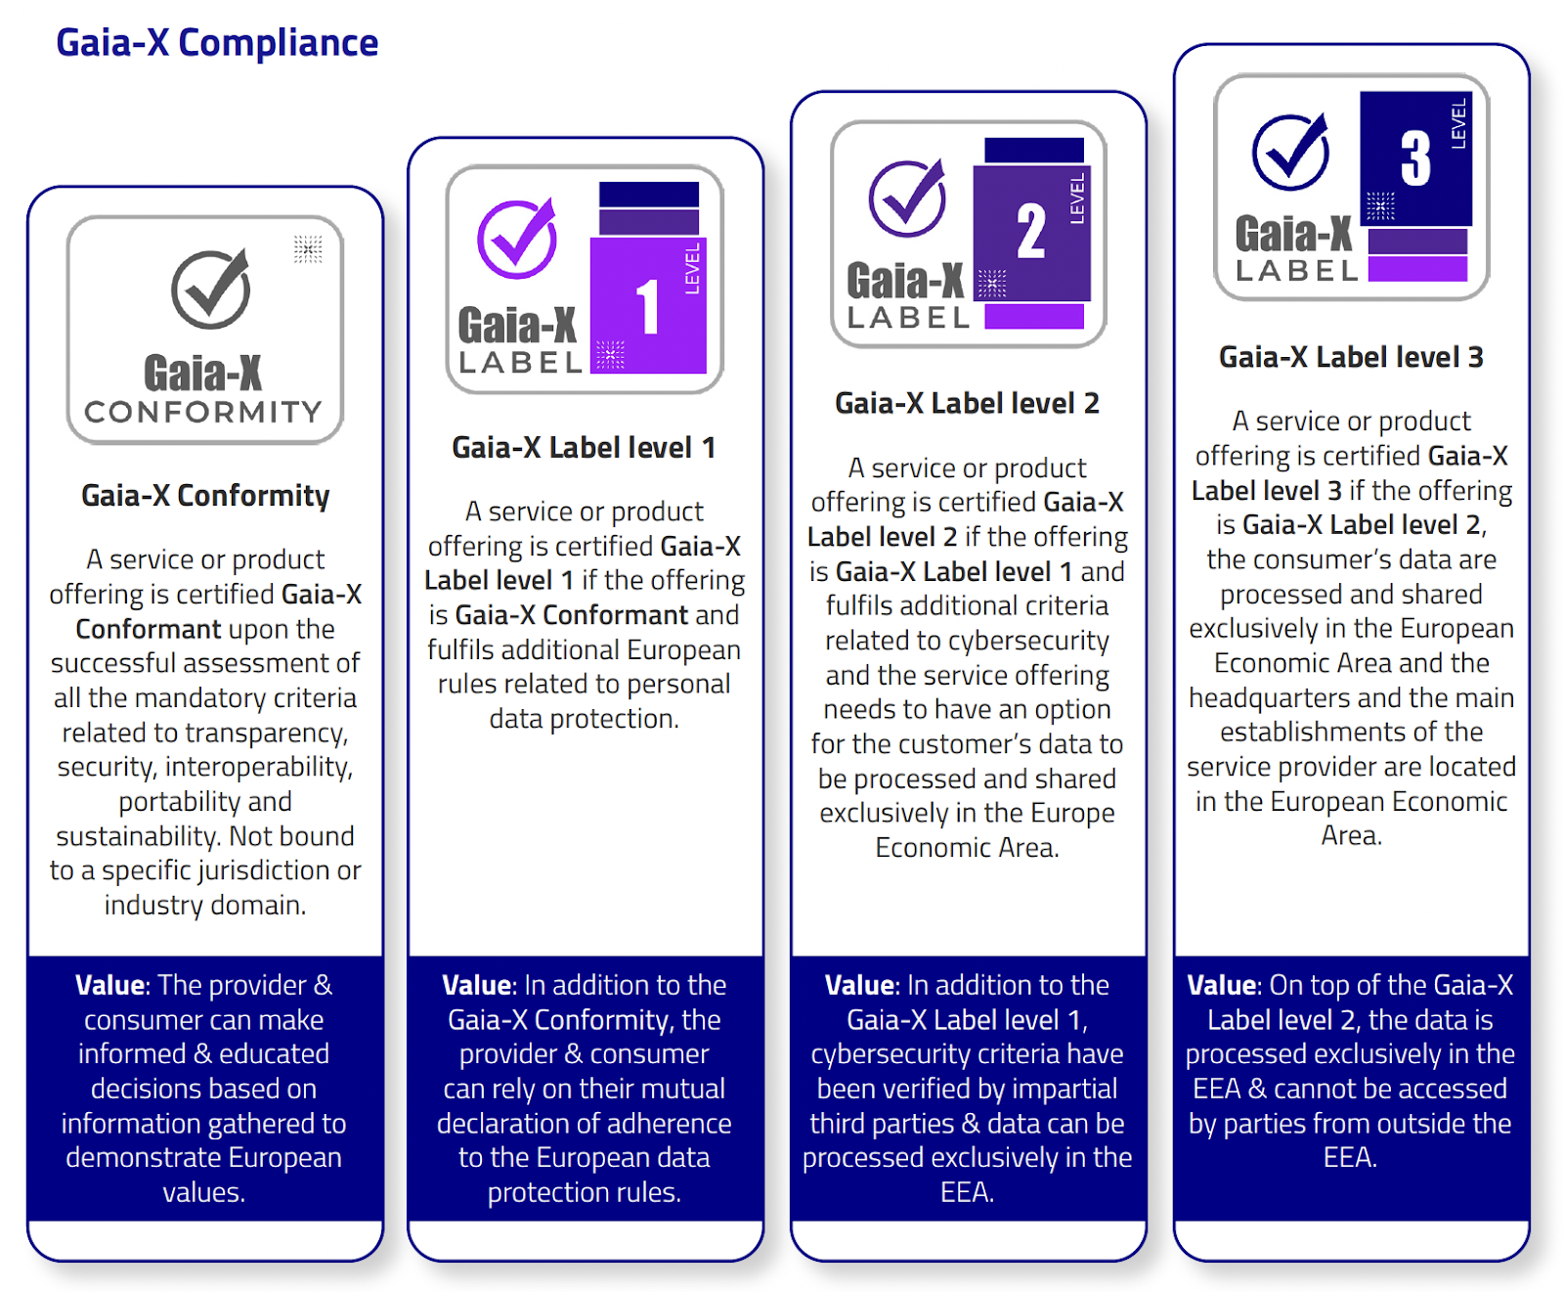
Verifiable Certifications are required for trusted decentralised replication

Slide 33
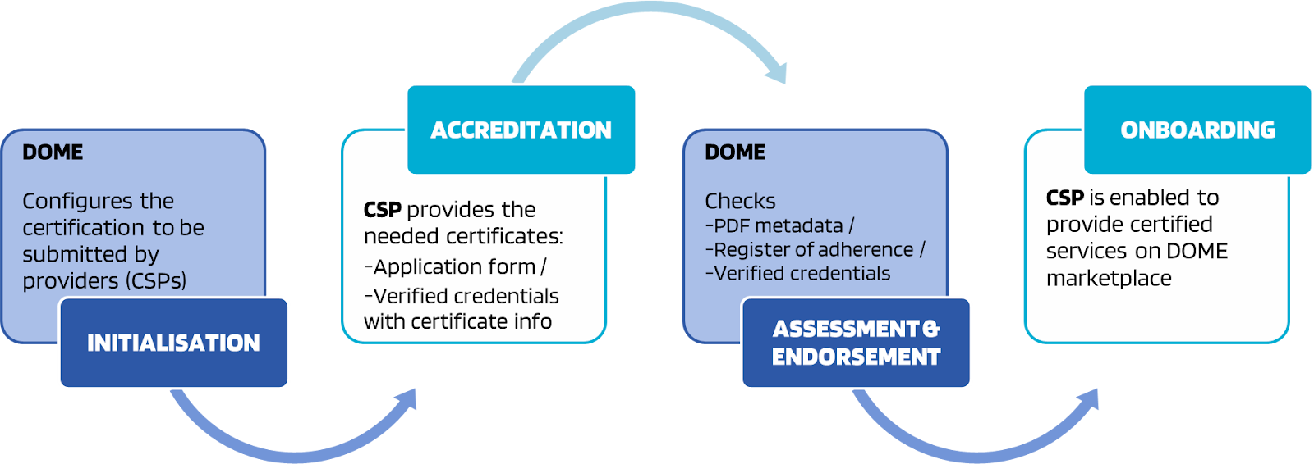
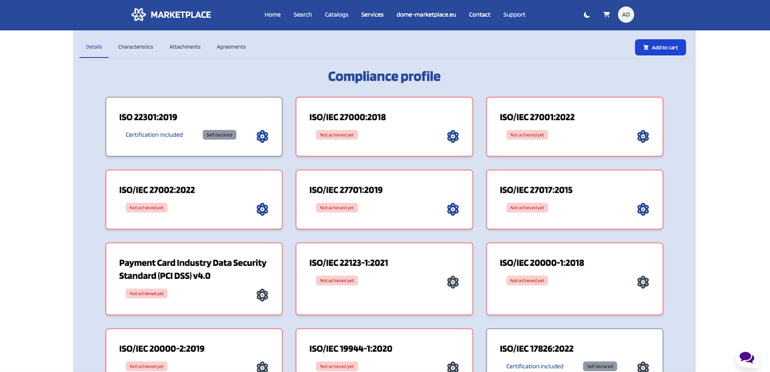
Proper
Level Of Assurance

Slide 34
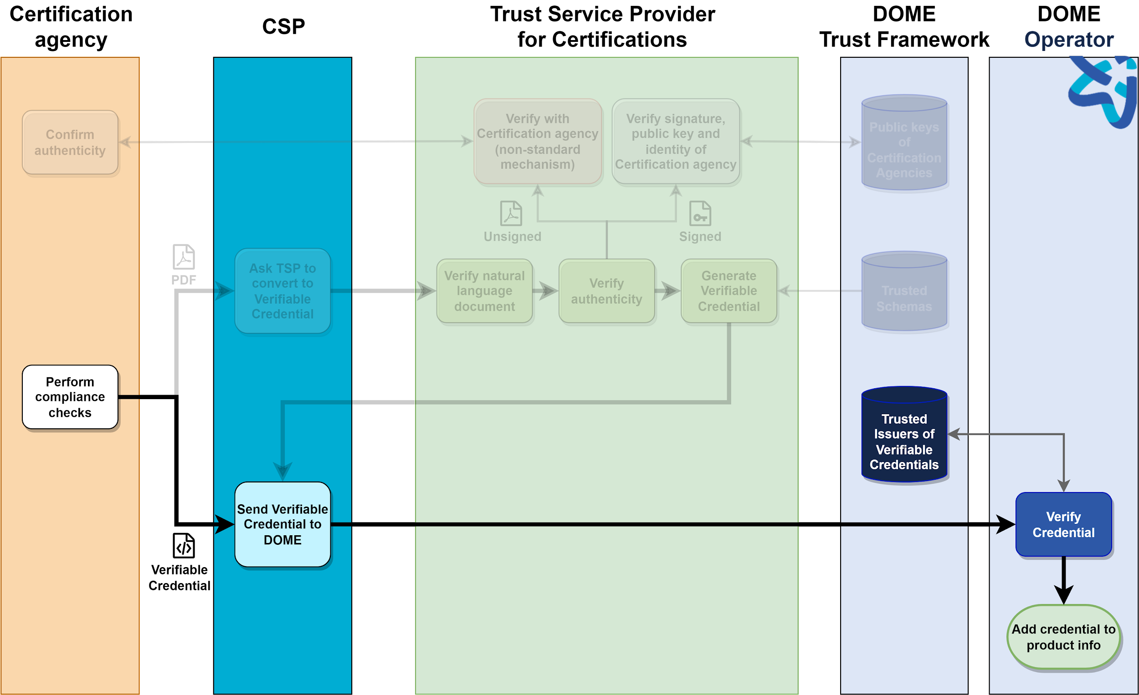
Future: the Certification agency issues a Verifiable Credential
The flow is very simple:
The CSP receives the certification in its enterprise wallet.
The CSP sends the certification to DOME onboarding.
DOME verifies automatically the authenticity of certification and that it is one of the required certifications.
Identities of certifications agencies are in the Trust Framework

Slide 35
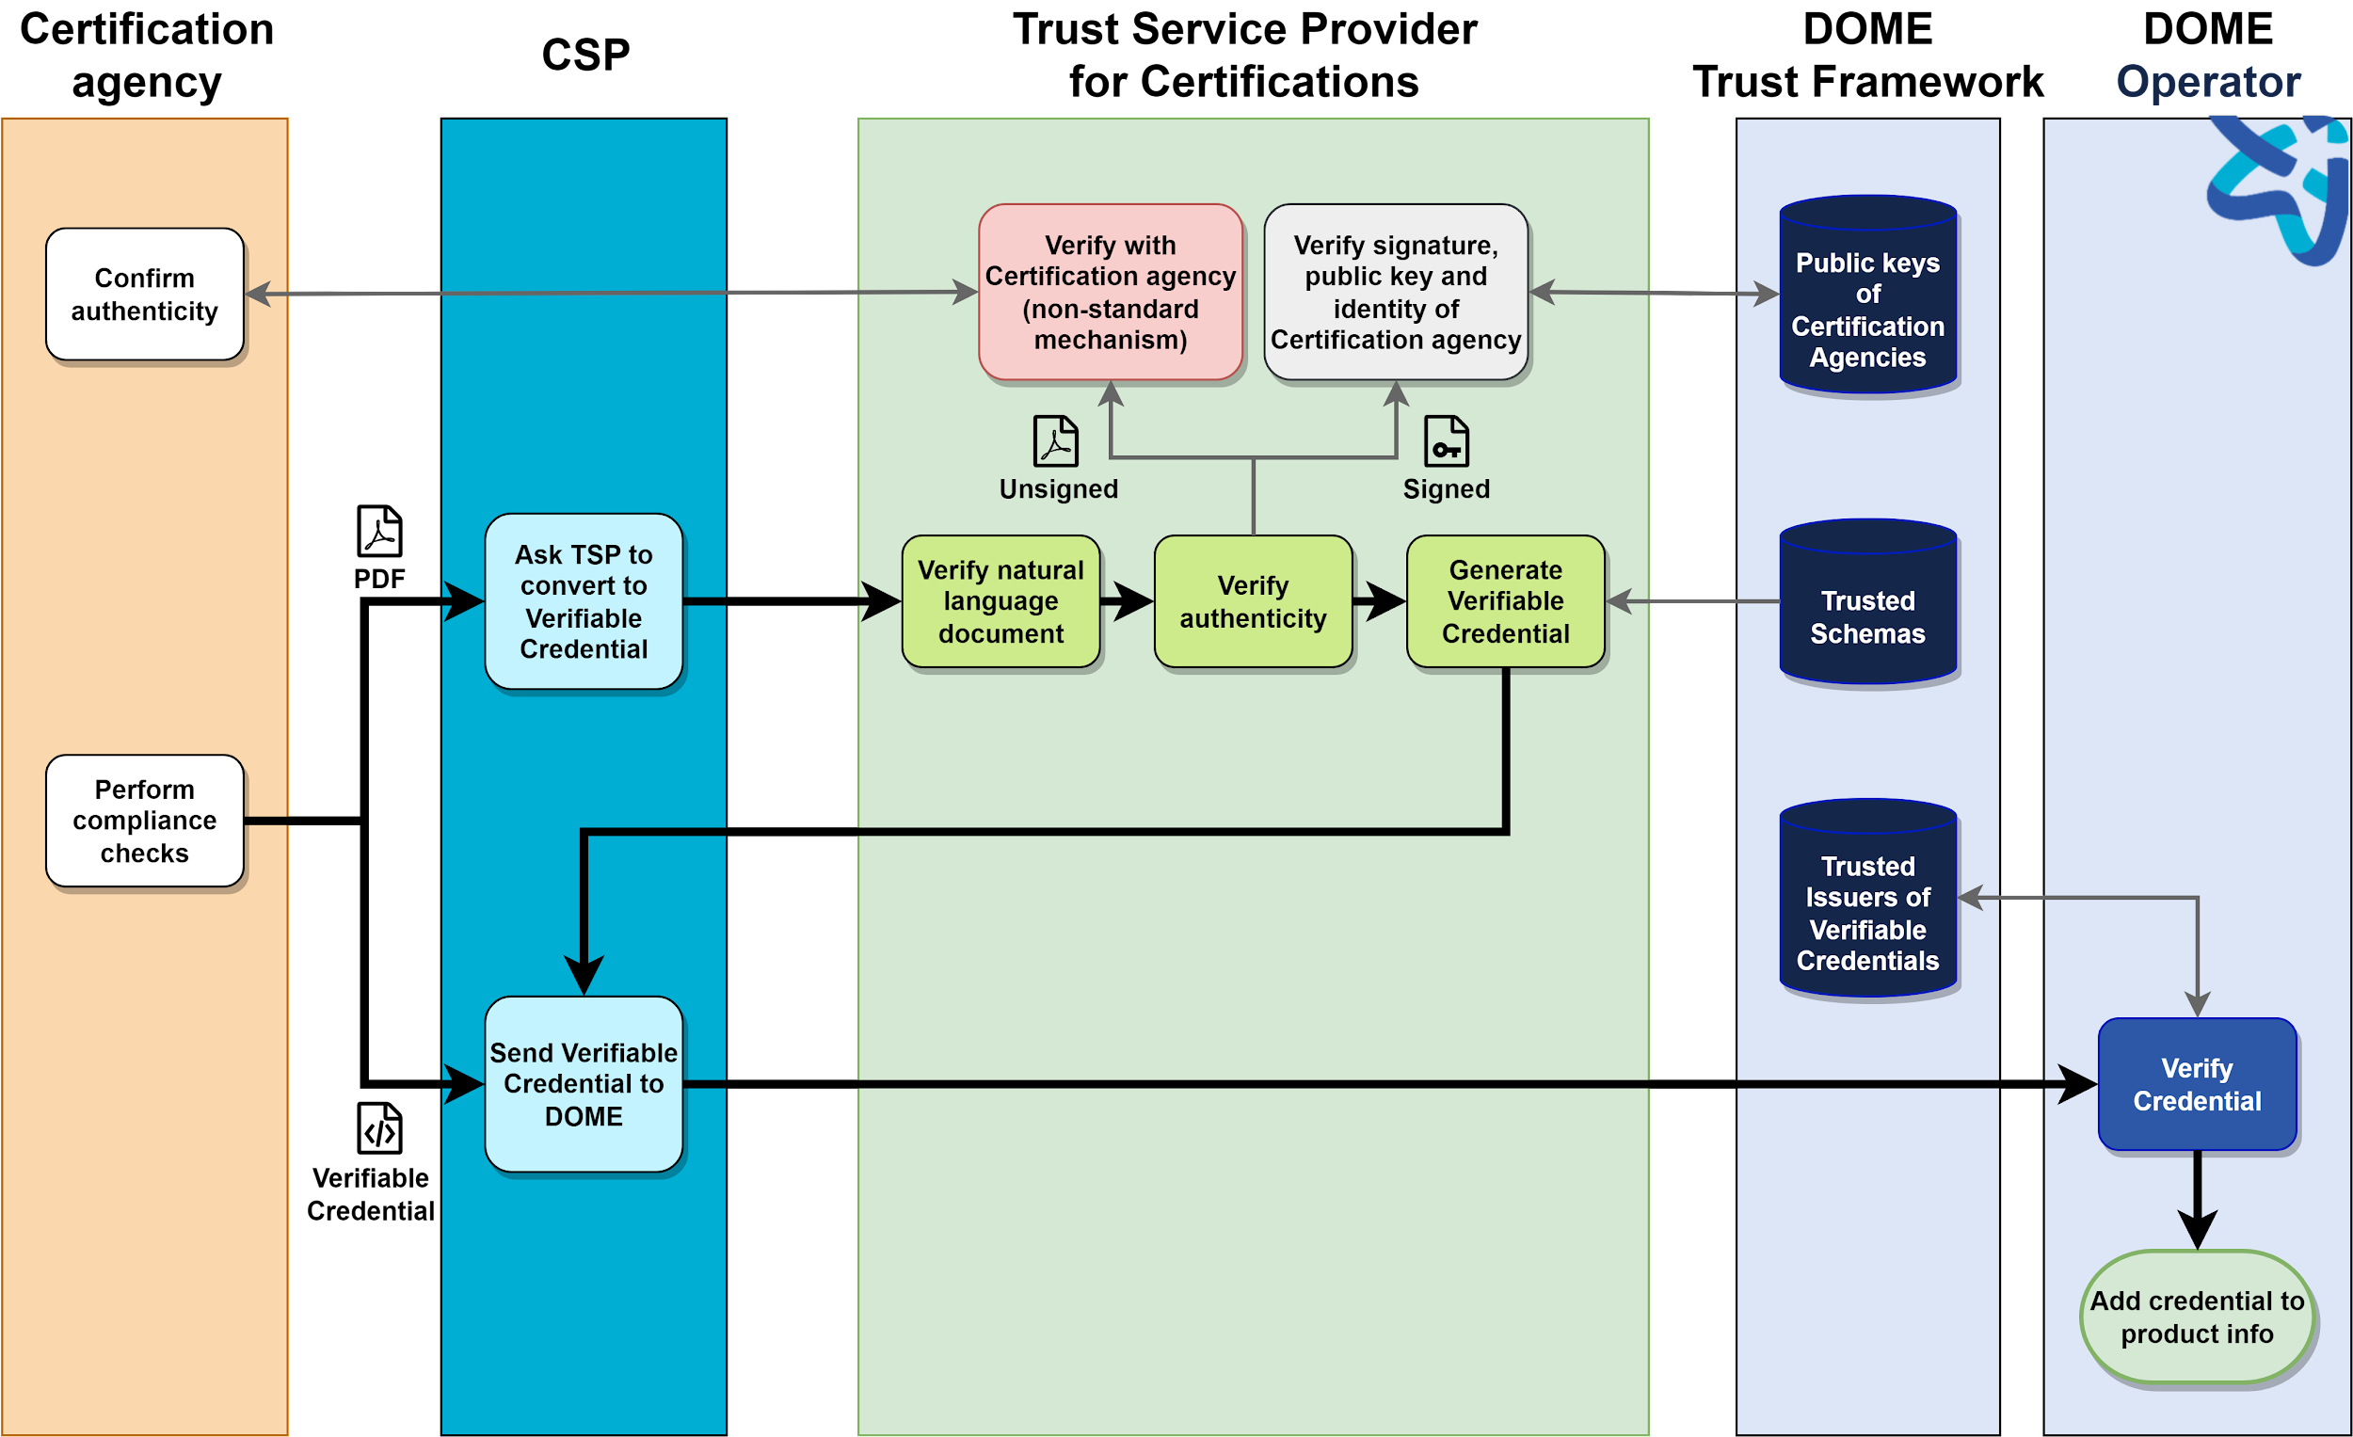
Today: services to “convert” PDF to Verifiable Credential
There is an intermediate trusted service:
Verifies the content of credential (typically natural language).
If it is not digitally signed, checks with the certification agency (may be manual or automatic).
If it is signed, checks signature, and that signer is authorised.
Generates a VC and returns it to CSP.
The Trusted Service can be provided by DOME and by other market operators.

Slide 36
Conclusion
Cloud & Edge services you can trust
dome-marketplace.eu

Slide 37
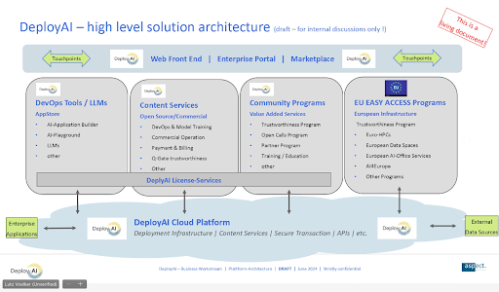
Possible federation
Bidirectional replication of selected product offerings

Slide 38
End
Cloud & Edge services you can trust
dome-marketplace.eu

